Slide 1

MUTX & Deadlocks

Slide 2
Mutex Lock (cont.)
Short for MUTual EXclusion object.
In computer programming, a mutex is a program object that allows multiple program threads to share the same resource, such as file access, but not simultaneously.
When a program is started, a mutex is created with a unique name.
After this stage, any thread that needs the resource must lock the mutex from other threads while it is using the resource.
The mutex is set to unlock when the data is no longer needed or the routine is finished.

Slide 3
Mutex Lock (cont.)
Mutex lock is used to protect the critical region and thus prevent race condition
A process must acquire the lock before entering a critical-section.
It release the lock when it exits the critical section.
The acquire() function acquire the lock and the release() function release the lock.

Slide 4
Mutex Lock (cont.)
A mutex lock has a boolean variable available whose value indicates if the lock is available or not.
If the lock is available, a call to acquire() succeeds, and then the lock is considered unavailable.
A process that attempts to acquire an unavailable lock is blocked until the lock is released.

Slide 5
Mutex Lock (cont.)
The definition of acquire() is as follows:
acquire()
{
while (!available);
available = false;
}
The definition of release() is as follows:
release()
{
available = true;
}

Slide 6
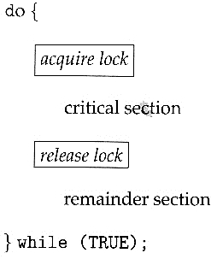
Mutex Lock (cont.)

Slide 7
Mutex Lock (cont.)
Calls to either acquire() or release() must be performed atomically.

Slide 8
Semaphores
Dijkestra proposed a significant technique for managing concurrent processes for complex mutual exclusion problems. He introduced a new synchronization tool called Semaphore.
Semaphores are of two types −
Binary semaphore
Counting semaphore

Slide 9
Counting Semaphores
These are integer value semaphores and have an unrestricted value domain.
These semaphores are used to coordinate the resource access, where the semaphore count is the number of available resources.
If the resources are added, semaphore count automatically incremented and if the resources are removed, the count is decremented.

Slide 10
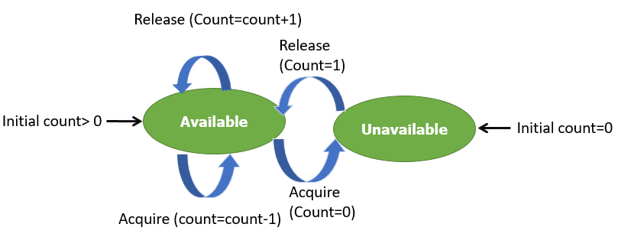

Slide 11
Binary Semaphores
The binary semaphores are like counting semaphores but their value is restricted to 0 and 1.
The wait operation only works when the semaphore is 1 and the signal operation succeeds when semaphore is 0.
It is sometimes easier to implement binary semaphores than counting semaphores.

Slide 12
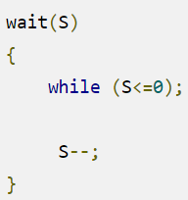
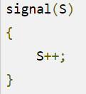
Cont.
WAIT
The wait operation decrements the value of its argument S, if it is positive. If S is negative or zero, then no operation is performed.
Signal
The signal operation increments the value of its argument S.

Slide 13
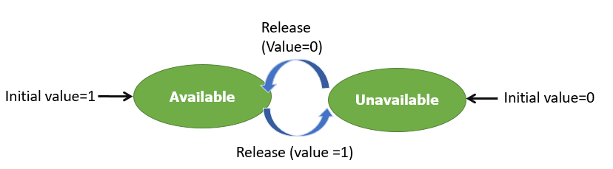

Slide 14
DEADLOCK

Slide 15
Background
The earliest computer operating systems ran only one program at a time.
All of the resources of the system were available to this one program.
Later, operating systems ran multiple programs at once, interleaving them.
Programs were required to specify in advance what resources they needed so that they could avoid conflicts with other programs running at the same time.

Slide 16
Background (Cont.)
Eventually some operating systems offered dynamic allocation of resources.
Programs could request further allocations of resources after they had begun running.
This led to the problem of the deadlock.

Slide 17
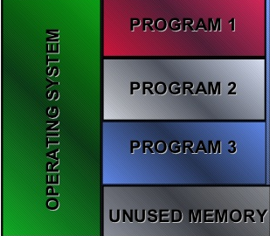
Introduction
In a multiprogramming environment, several processes may compete for a finite number of resources.
A process requests resources; if the resources are not available at that time, the process enters a waiting state.
Sometimes, a waiting process is never again able to change state, because the resources it has requested are held by other waiting processes.
This situation is called a deadlock.

Slide 18
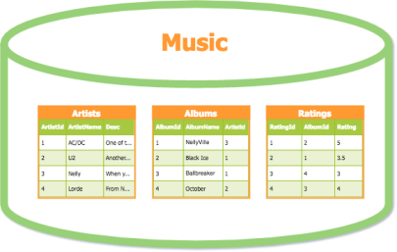

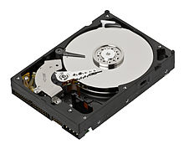


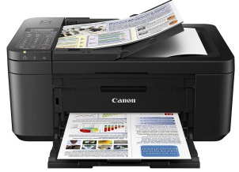
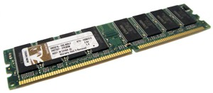
Resources
Examples of computer resources
Printers
Storage
Tables in a database
A process must request a resource before using it and must release the resource after using it.
A process may request as many resources as it requires to carry out its designated task.
The number of resources requested may not exceed the total number of resources available in the system.

Slide 19
System Model
A system consists of a finite number of resources to be distributed among a number of competing processes.
The resources may be partitioned into several types (or classes), each consisting of some number of identical instances.
CPU cycles, files, and I/O devices (such as printers and DVD drives) are examples of resource types.
If a system has two CPUs, then the resource type CPU has two instances.
Similarly, the resource type printer may have five instances.

Slide 20
Resources Access
Under the normal mode of operation, a process may utilize a resource in only the following sequence:
1. Request: If the request cannot be granted immediately (for example, if the resource is being used by another process), then the requesting process must wait until it can acquire the resource.
2. Use: The process can operate on the resource (for example, if the resource is a printer, the process can print on the printer).
3. Release: The process releases the resource.

Slide 21
Deadlock
“A situation in which a set of blocked processes each holding a resource and waiting to acquire a resource held by another process in the set is called deadlock.”

Slide 22
Example
Program 1 requests resource A and receives it.
Program 2 requests resource B and receives it.
Program 1 requests resource B and is queued up, pending the release of B.
Program 2 requests resource A and is queued up, pending the release of A.
Example: System has 2 tape drives. P0 and P1 each hold one tape drive and each needs another one.

Slide 23
Bridge Crossing Example
Traffic only in one direction.
Each section of a bridge can be viewed as a resource.
If a deadlock occurs, it can be resolved if one car backs up (preempt resources and rollback).
Several cars may have to be backed up if a deadlock occurs.
Starvation is possible.

Slide 24
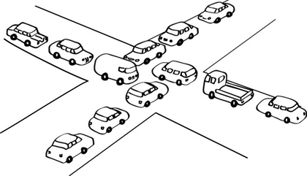

Slide 25
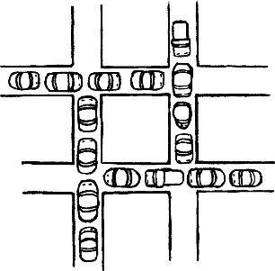

Slide 26
System Model (Cont.)
A set of processes is in a deadlocked state when every process in the set is waiting for an event that can be caused only by another process in the set.
The events with which we are mainly concerned here are resource acquisition and release.
The resources may be either physical resources (for example, printers, tape drives, memory space, and CPU cycles) or logical resources (for example, semaphores, mutex locks, and files).
However, other types of events may result in deadlocks

Slide 27
Deadlock Example
To illustrate a deadlocked state, consider a system with three CD RWdrives.
Suppose each of three processes holds one of these CDRWdrives.
If each process now requests another drive, the three processes will be in a deadlocked state.
Each is waiting for the event “CD RW is released,” which can be caused only by one of the other waiting processes.
This example illustrates a deadlock involving the same resource type.

Slide 28
DEADLOCK CHARACTERISATION
In a deadlock, processes never finish executing, and system resources are tied up, preventing other jobs from starting.
A deadlock situation can arise if the following four conditions hold simultaneously in a system
Mutual Exclusion
Hold and wait
No preemption
Circular Wait

Slide 29
Necessary Conditions
Mutual exclusion: At least one resource must be held in a non-sharable mode; that is, only one process at a time can use the resource.
If another process requests that resource, the requesting process must be delayed until the resource has been released.

Slide 30
Necessary Conditions (Cont.)
Hold and wait: A process must be holding at least one resource and waiting to acquire additional resources that are currently being held by other processes.
No preemption: Resources cannot be preempted; that is, a resource can be released only voluntarily by the process holding it, after that process has completed its task.

Slide 31
Necessary Conditions (Cont.)
Circular wait A set {P0, P1, ..., Pn} of waiting processes must exist such that P0 is waiting for a resource held by P1, P1 is waiting for a resource held by P2, ..., Pn−1 is waiting for a resource held by Pn, and Pn is waiting for a resource held by P0.

Slide 32
Resource-Allocation Graph
What is a Resource Allocation Graph?
A resource allocation graph tracks which resource is held by which process and which process is waiting for a resource of a particular type.
It is very powerful and simple tool to illustrate how interacting processes can deadlock.
If a process is using a resource, an arrow is drawn from the resource node to the process node.
If a process is requesting a resource, an arrow is drawn from the process node to the resource node.

Slide 33
Resource Allocation Graph
In some cases deadlocks can be understood more clearly through the use of Resource-Allocation Graphs, having the following properties:
A set of resource categories, { R1, R2, R3, . . ., RN }, which appear as square nodes on the graph.
Dots inside the resource nodes indicate specific instances of the resource (E.g. two dots might represent two laser printers)
A set of processes { P1, P2, P3, . . ., PN }

Slide 34
Resource Allocation Graph (Cont.)
Request Edges - A set of directed arcs from Pi to Rj, indicating that process Pi has requested Rj, and is currently waiting for that resource to become available.
Assignment Edges - A set of directed arcs from Rj to Pi indicating that resource Rj has been allocated to process Pi, and that Pi is currently holding resource Rj.

Slide 35
Resource Allocation Graph
Note that a request edge can be converted into an assignment edge by reversing the direction of the arc when the request is granted.
However note also that request edges point to the category box, whereas assignment edges emanate from a particular instance dot within the box.

Slide 36
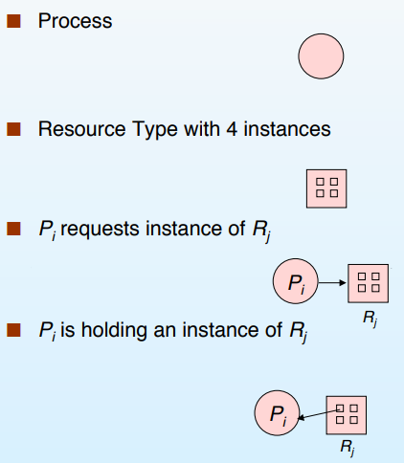
Graphical Representation of Process and Resource

Slide 37
Resource Allocation Graph
If a resource-allocation graph contains no cycles, then the system is not deadlocked. ( When looking for cycles, remember that these are directed graphs).
If a resource-allocation graph does contain cycles AND each resource category contains only a single instance, then a deadlock exists.
If a resource category contains more than one instance, then the presence of a cycle in the resource-allocation graph indicates the possibility of a deadlock, but does not guarantee one.

Slide 38
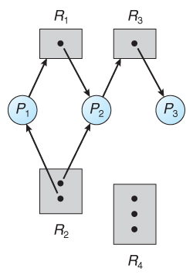
Example

Slide 39
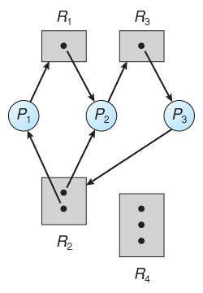
Resource allocation graph with a deadlock

Slide 40
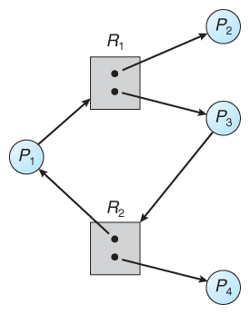
Resource allocation graph with a cycle but no deadlock

Slide 41
Basic Facts
If graph contains no cycles ⇒ no deadlock.
If graph contains a cycle ⇒
if only one instance per resource type, then deadlock.
if several instances per resource type, possibility of deadlock.

Slide 42
Question?

